Slide 1
Branch4
BART Analytics

Slide 2
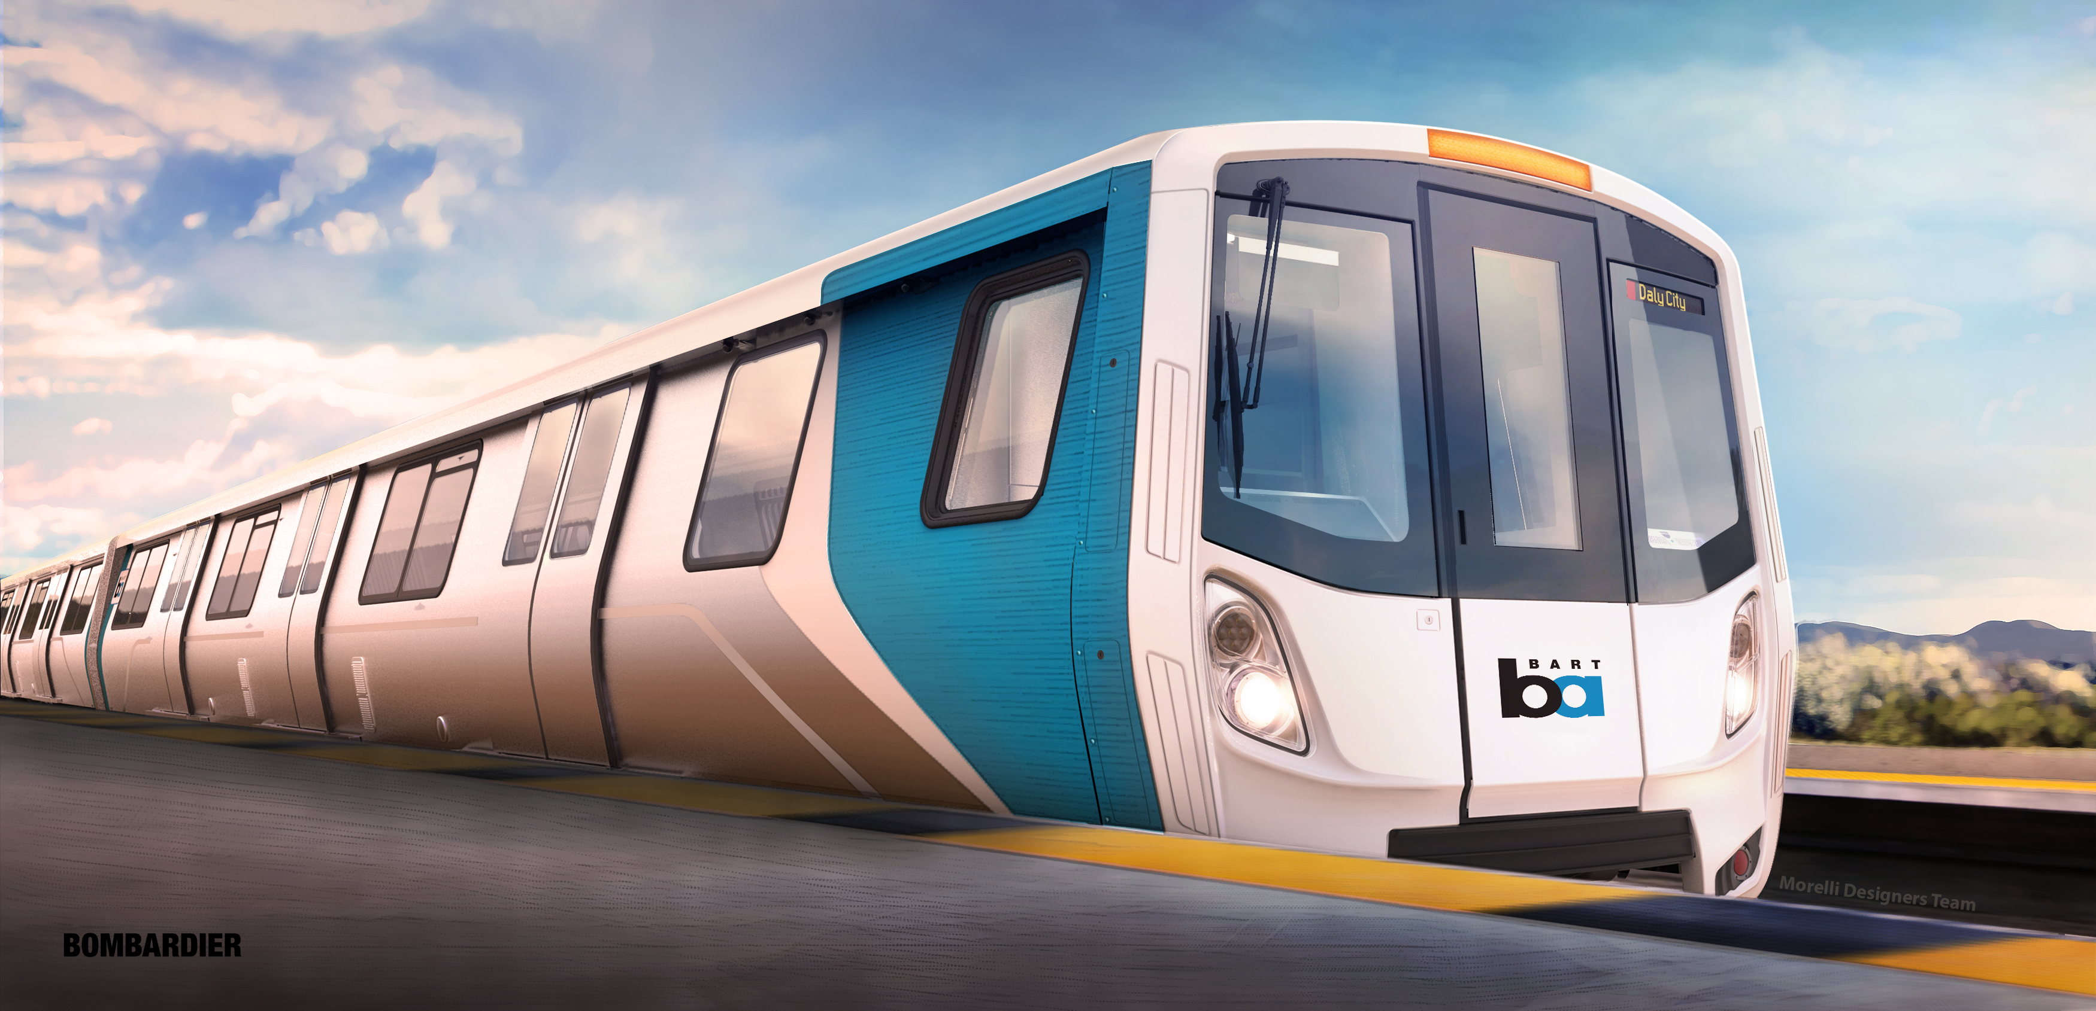
To ride or not to ride Bart?

Slide 3
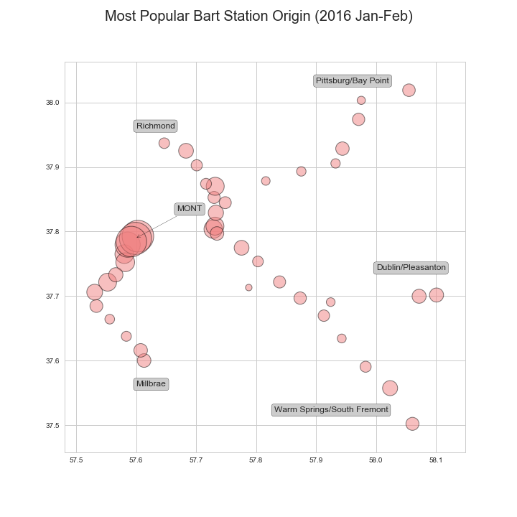
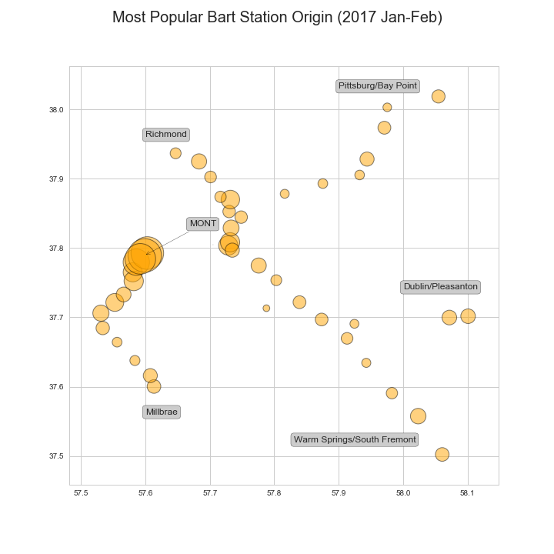
Super Bowl Impact– Origin station (Jan-Feb)

Slide 4
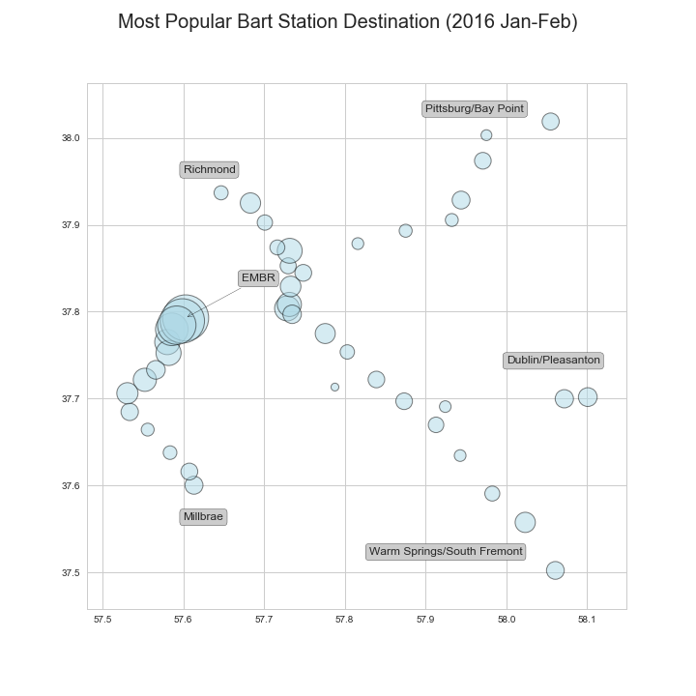
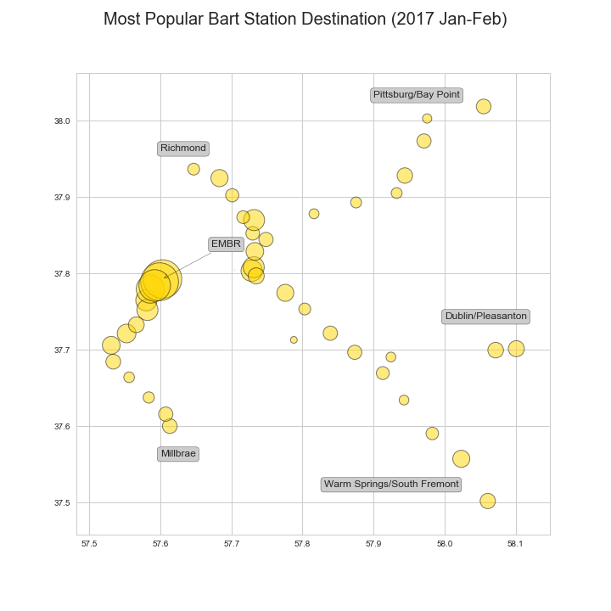
Super Bowl Impact– Destination (Jan-Feb)

Slide 5
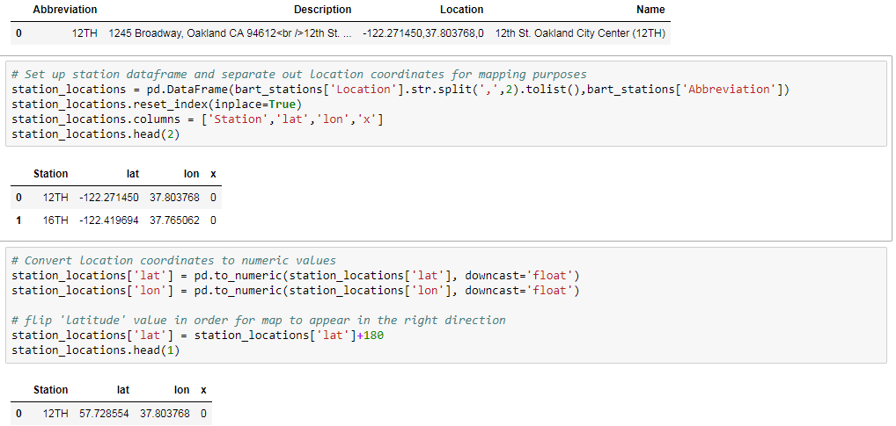
Key Learnings – Code
Station Location mapping required: Splitting out coordinates, converting to numeric and flipping direction:

Slide 6
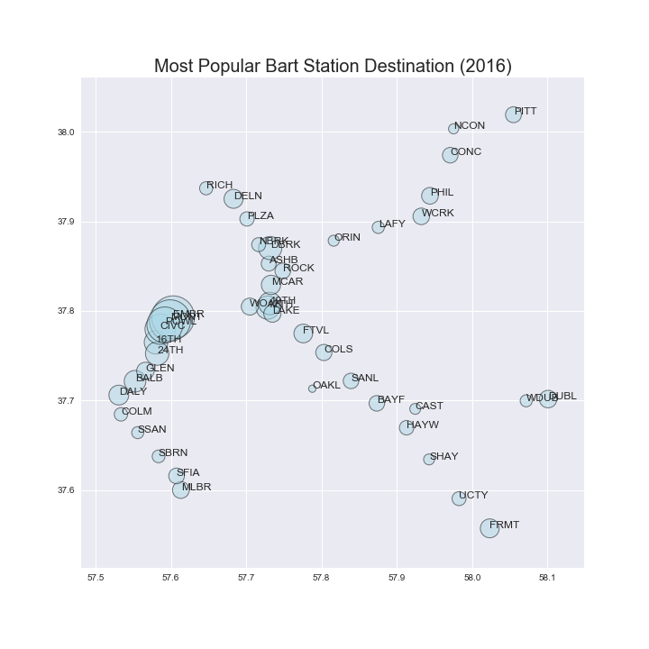
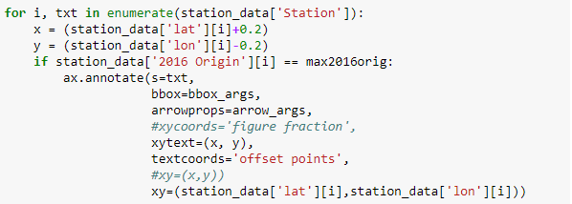
Key Learnings – Focus on Question
Original plan: add station names to all data points
Final result: add end point stations only and highlight most popular station

Slide 7
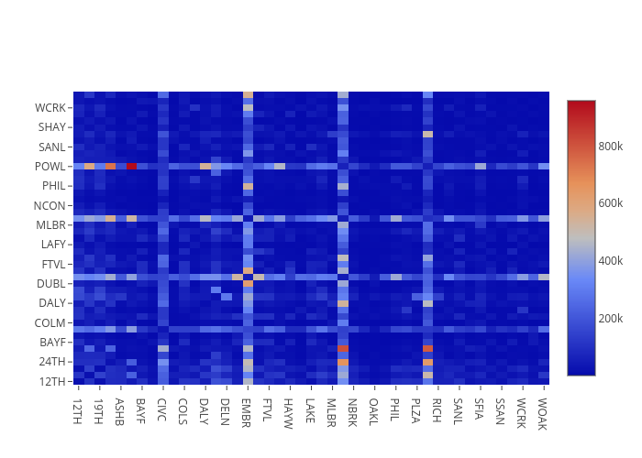
Throughput Between Stations (2015)
https://plot.ly/~tli2001/8/

Slide 8
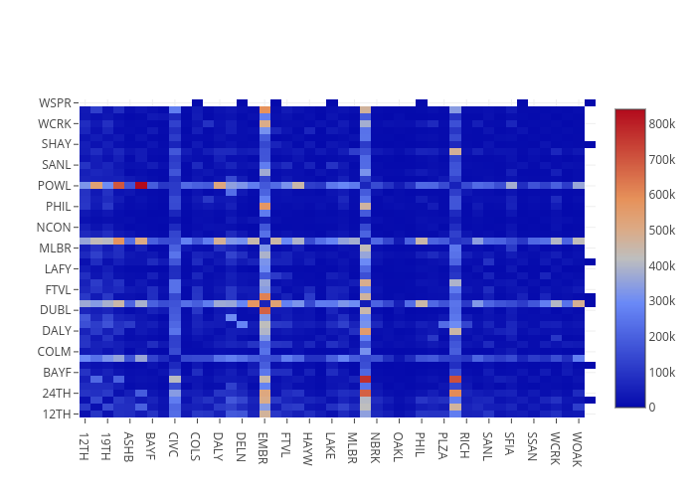
Throughput Between Stations (2016)
https://plot.ly/~tli2001/4/

Slide 9

Throughput Between Stations (2017 Jan-May)
https://plot.ly/~tli2001/6/

Slide 10
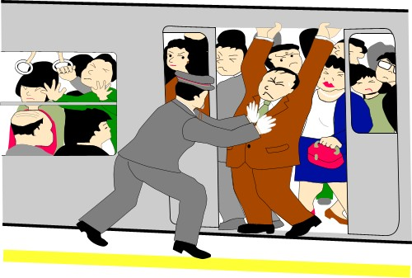

Popular Station Findings
Comparing the throughput of January-February of 2016 and 2017, there was an overall decrease in traffic in the year following the Super Bowl. We saw an average drop of 33,000 across all stations, including a drop of over 200,000 in the most popular destination station in both years – Embarcadero Station.
Looking at the full year throughput between 2015 and 2016 (2017 data was incomplete) we can see that the overall traffic pattern between stations looked largely similar, so the Super Bowl primarily added volume but did not alter the traffic pattern .
Verdict: If you need to travel to or through downtown San Francisco - specifically Embarcadero, Montgomery, Powell, or Civic Center, there’s a high possibility of the trains being packed due to the popularity of these stations.

